Slide 1


TCP Congestion Control & DNS
SE3331-1 (2024 Fall)
IPADS, Shanghai Jiao Tong University
https://www.sjtu.edu.cn
xx

Slide 2
End-to-end Layer

Slide 3
Review: Assurance of End-to-end Protocol
Assurance of at-least-once delivery
Assurance of at-most-once delivery
Assurance of data integrity
Assurance of stream order & closing of connections
Assurance of jitter control
Assurance of authenticity and privacy
Assurance of end-to-end performance

Slide 4
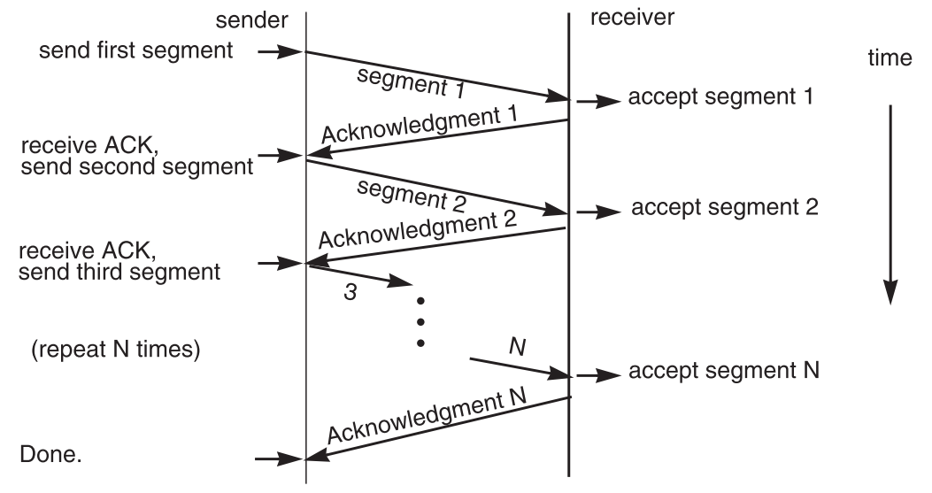
7. End-to-end Performance
Multi-segment message questions
Trade-off between complexity and performance
Lock-step protocol

Slide 5
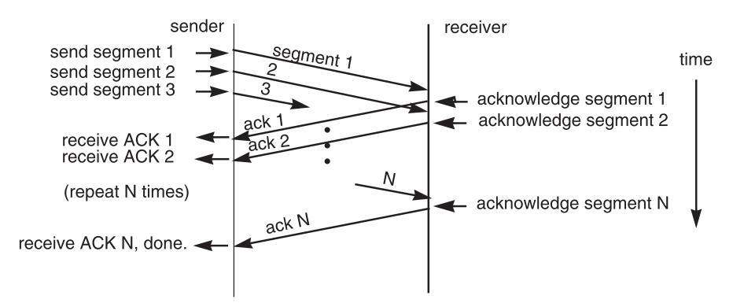
Overlapping Transmissions (Pipeline style)

Slide 6
Overlapping Transmissions
Packets or ACK may be lost
Sender holds a list of segments sent, check it off when receives ACK
Set a timer (according to RTT) for last segment
If list of missing ACK is empty, OK
If timer expires, resend packets and another timer

Slide 7
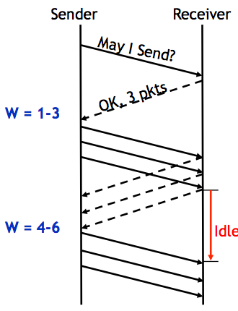
Fixed Window
Receiver tells the sender a window size
Sender sends window
Receiver acks each packet as before
Window advances when all packets in previous window are acked
E.g., packets 4-6 sent, after 1-3 ack'd
If a packet times out -> resend packets
Still much idle time

Slide 8
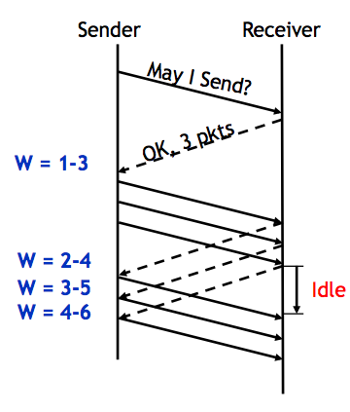
Sliding Window
Sender advances the window by 1 for each in-sequence ACK it receives
Reduces idle periods
Pipelining idea
But what's the correct value for the window?
We'll revisit this question
First, we need to understand windows

Slide 9
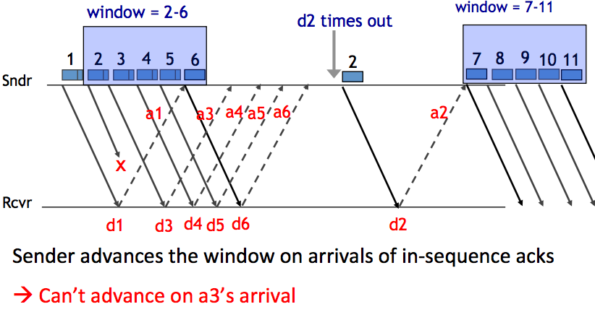
Handling Packet Loss

Slide 10
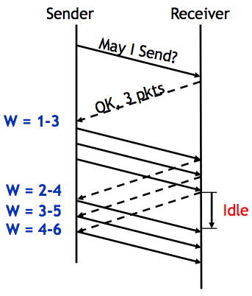
Chose the Right Window Size
If window is too small
Long idle time
Underutilized network
If window too large
Congestion

Slide 11
Sliding Window Size
window size ≥ round-trip time × bottleneck data rate
Sliding window with one segment in size
Data rate is window size / RTT
Enlarge window size to bottleneck data rate
Data rate is window size / RTT
Enlarge window size further
Data rate is still bottleneck
Larger window makes no sense
- Receive 500 KBps
- Sender 1 MBps
- RTT 70ms
- A segment carries 0.5 KB
- Sliding window size = 35KB (70 segment)

Slide 12
Self-pacing: Sliding Window Size
Although the sender doesn't know the bottleneck, it is sending at exactly that rate
Once sender fills a sliding window, cannot send next data until receive ACK of the oldest data in the window
The receiver cannot generate ACK faster than the network can deliver data elements
RTT estimation still needed

Slide 13
TCP Congestion Control

Slide 14
Congestion
Definition: Too many packets present in (a part of) the network causes packet delay and loss that degrades performance.
Network & End-to-end layers share the responsibility for handling congestion
1. Network layer
Directly experiences the congestion
Ultimately determine what to do with the excess packets
2. End-to-end layer
Control to reduce the sending rate, is the most effective way

Slide 15
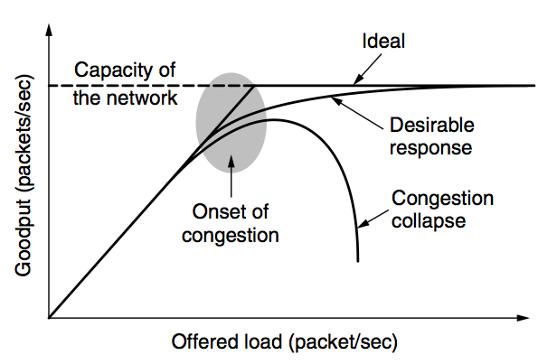
Network Congestion

Slide 16
Why Congest?
If all of a sudden, streams of packets begin arriving on three or four input lines and all need the same output line, a queue will build up
If there is insufficient memory to hold all of them, packets will be lost
Adding more memory may help up to a point, but
Nagle (1987) realized that if routers have an infinite amount of memory, congestion gets worse, not better
This is because by the time packets get to the front of the queue, they have already timed out (repeatedly) and duplicates have been sent

Slide 17
Load Shedding: Setting Window Size
For performance:
window size ≥ round-trip time × bottleneck data rate
For congestion control:
window size ≤ min(RTT x bottleneck data rate, Receiver buffer)
Congestion window
2 windows become 1
to achieve best performance and avoid congestion

Slide 18
Congestion Control
Basic idea:
Increase congestion window slowly
If no drops -> no congestion yet
If a drop occurs -> decrease congestion window quickly
Use the idea in a distributed protocol that achieves:
Efficiency: i.e., uses the bottleneck capacity efficiently
Fairness, i.e., senders sharing a bottleneck get equal throughput (if they have demands)

Slide 19
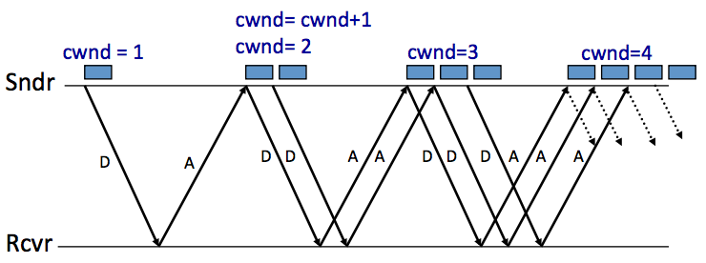
AIMD (Additive Increase, Multiplicative Decrease)
Every RTT:
No drop: cwnd = cwnd + 1
A drop: cwnd = cwnd / 2

Slide 20
Problems with AIMD
Increases very slowly at the beginning
Initial window size is 1
Probably too small in practice
Solution: do multiplicative increase at the beginning
Congestion_window _{init} = 1
Initially, do Congestion_window ← 2 * Congestion_window each RTT until we hit congestion
Named "slow start" (even though it's exponentially fast!)

Slide 21
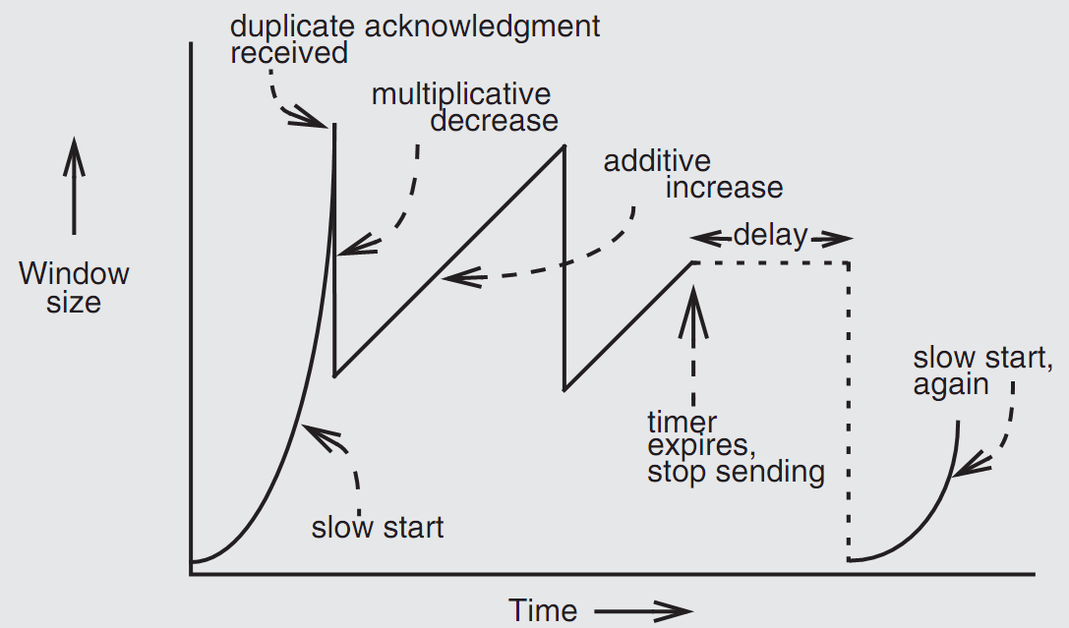
Retrofitting TCP

Slide 22
Retrofitting TCP
1. Slow start: one packet at first, then double until
Sender reaches the window size suggested by the receiver
All the available data has been dispatched
Sender detects that a packet it sent has been discarded
2. Duplicate ACK
When receiver gets an out-of-order packet, it sends back a duplicate of latest ACK
3. Equilibrium
AIMD: Additive increase & multiplicative decrease
4. Restart, after waiting a short time

Slide 23
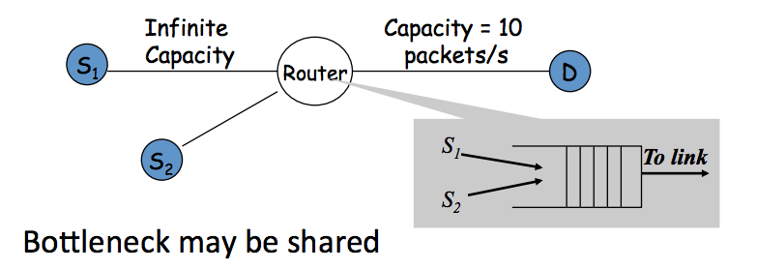
Fairness between Links

Slide 24
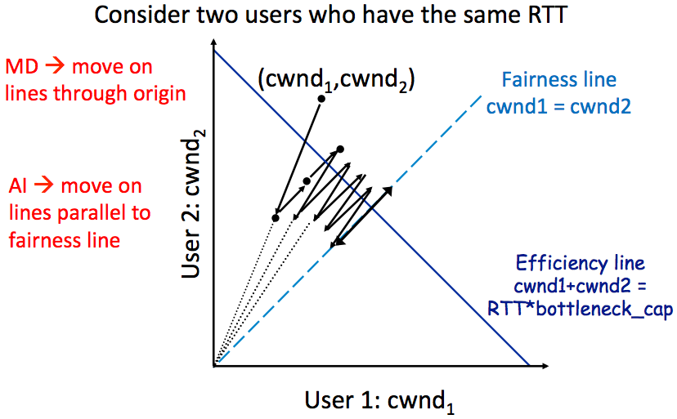
AIMD Leads to Efficiency and Fairness

Slide 25
Q: Why not Additive Decrease
It does not converge to fairness
from a congested point, (x',y'), reducing each by 1 worsens fairness and takes us away from the "ideal" outcome

Slide 26
Weakness of TCP
If routers have too much buffering, causes long delays
Packet loss is not always caused by congestion
Consider wireless network: if losing packet, sender may send faster instead
TCP does not perform well in datacenters
High bandwidth, low delay situations
TCP has a bias against long RTTs
Throughput inversely proportionally to RTT
Consider when sending packets really far away vs really close
Assumes cooperating sources, which is not always a good assumption

Slide 27
Summary of Congestion Window
Reliability Using Sliding Window
Tx Rate = W / RTT
Congestion Control
W = min(Receiver_buffer, cwnd)
Congestion window is adapted by the congestion control protocol to ensure efficiency and fairness
TCP congestion control uses AIMD which provides fairness and efficiency in a distributed way

Slide 28
The Design of DNS
Domain Name Service

Slide 29
DNS: Binding IP and Domain Name
Names: hostname strings
E.g., www.sjtu.edu.cn
Values: IP addresses
E.g., 202.120.2.119
Look-up algorithm
Resolves a hostname to an IP address so that your machine knows where to send packets

Slide 30
IP Address as a Type of Name
An IP address itself is a type of name
A structured name that is used to locate an object
Use IP address to identify the server
Recall your labs in ICS on socket
On Internet
The router will know where to send a packet with destination IP
Hostname has no such semantic
A router does not know how to send a packet to "baidu.com"

Slide 31
Why Not Just Using IP Address?
IPs are structured in a particular way for routing
You cannot choose your IP address as you wish
Note: usually an address cannot be picked
While you can choose your host names
IPs are not user-friendly enough

Slide 32
Questions on DNS
Q: Can a name have multiple values (IP addresses)?
Yes. This allows a web server to balance its load over multiple machines
Also allows a client to choice a nearest IP to access
Q: Can a single value have multiple names?
Yes. This allows server consolidation
Q: Can the value corresponding to a name change?
Yes. This allows to change the physical machine (with different IP) that stores the data without changing the hostname
Such changing is hidden to clients

Slide 33
Look-up Algorithm
At first, each machine kept a "hosts.txt" for address binding
E.g., "r900 202.120.224.83"
Using table look-up to resolve the binding
This method cannot scale in Internet
1984, four Berkeley students wrote BIND
Berkeley Internet Name Domain
Still the dominant DNS software in use

Slide 34
Distributing Responsibility
The binding
Too large to be stored on a single machine
Thus, the data are stored on many machines
As known as "name servers"
How to know which name server has a particular binding?
Solution: structure the hostname
Names have a hierarchy, e.g., com, net, gov, correspond to "zones"
Zones are mapped to name servers

Slide 35

Name Servers
The root zone
Maintained by ICANN, non-profit
The ".com" zone
Maintained by VeriSign, add for money
The ".sjtu.edu.cn" zone
Maintained by SJTU

Slide 36
DNS Hierarchy (a partial view)

Slide 37
Basic DNS Look-up Algorithm
Example: lookup IP of "ipads.se.sjtu.edu.cn"
Traverse the name hierarchy from the root
The root will tell us the "cn" name server IP,
which will tell us the "edu.cn" name server IP,
which will tell us the "sjtu.edu.cn" name server IP,
which will tell us the "se.sjtu.edu.cn" name server IP,
which finally tells us the "ipads.se.sjtu.edu.cn" IP
Such algorithm is called delegation

Slide 38
DNS Lookup

Slide 39
DNS Lookup

Slide 40
DNS Lookup

Slide 41
DNS Lookup

Slide 42
DNS Lookup

Slide 43
Context in DNS
Names in DNS are global (context-free)
A hostname means the same thing everywhere in DNS
Actually, it should be "ipads.se.sjtu.edu.cn."
A hostname is a list of domain names concatenated with dots
The root domain is unnamed, i.e., "." + blank

Slide 44
Fault Tolerant
Each zone can have multiple name servers
A delegation usually contains a list of name servers
If one name server is down, others can be used

Slide 45
Three Enhancements on Look-up Algorithm
1. The initial DNS request can go to any name server, not just the root server
Even on your own machine: /etc/hosts
You can specific name servers in /etc/resolv.conf
If no record, just return address of the root server
Q: what are the benefits?
Notes:
To minimize the load of the root server.

Slide 46
Three Enhancements on Look-up Algorithm
2. Recursion
A client asks a name server "www.baidu.com"
The name server does all the lookup through the tree and return the IP of Baidu to the client
Usually, a name server has a better network connection

Slide 47
DNS Request Process
a.root.net
a.root.net
names.edu
names.edu
NS: for edu
ns.iss.edu
ns.iss.edu
NS: for
Scholarly.edu
ginger.
Scholar.edu
ginger.
Scholar.edu
ginger.
Scholar.edu
AP: for
ginger.Scholar.edu
Name client
Name client
Non-Recursion
Recursion

Slide 48
Three Enhancements on Look-up Algorithm
3. Caching
DNS clients and name servers keep a cache of names
Your browser will not do two look-ups for one address
Cache has expire time limit
Controlled by a time-to-live parameter in the response itself
E.g., SJTU sets the TTL of www.sjtu.edu.cn to 24h
TTL (Time To Live)
Long TTL VS. short TTL
Q: what are the tradeoffs?

Slide 49
Combine These Enhancements
If:
Many machines at SJTU use the SJTU name server for their initial DNS query, and
The name server offers recursive querying and caching
Then:
The name server's cache will hold many bindings, and
Performance benefits from this large cache

Slide 50
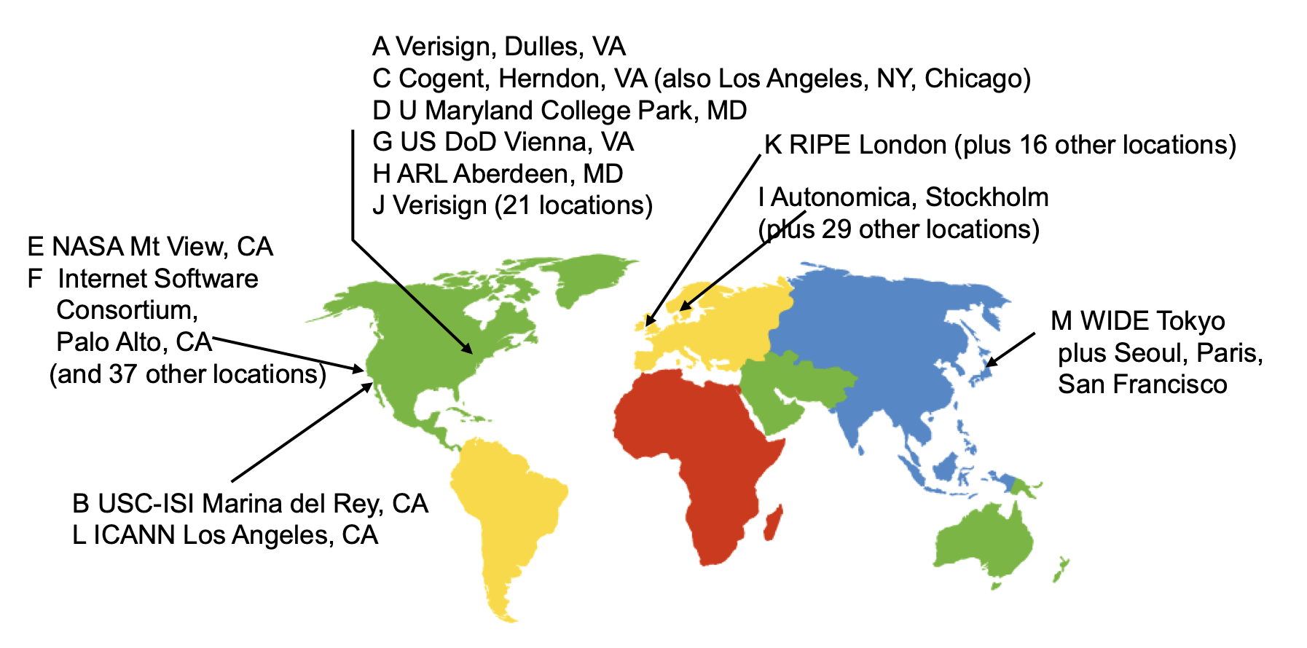
Other Features of DNS
At least two identical replica servers
80 replicas of the root name server in 2008
Replicas are placed separated around the world

Slide 51
Other Features of DNS
Organization's name server (e.g., SJTU)
Several replicas in campus
To enable communications within the organization
At least one out of the campus
To validate the address for outside world

Slide 52
Name Discovery in DNS (at the first place)
A client must discover the name of a nearby name server
Name discovery broadcast to ISP at first time
Ask network manager
Ask by email, Google, etc.

Slide 53
Comparing Hostname & Filename
They are both for more user friendly
File-name -> inode number
Host-name -> IP address
File-name and host-name are hierarchical; inode num and IP addr. are plane
They are both not a part of the object
File-name is not a part of a file (stored in directory)
Host-name is not a part of a website (stored on name server)
Name and value binding
File: 1-name -> N-values (no); N-name -> 1-value (yes)
DNS: 1-name -> N-values (yes); N-name -> 1-value (yes)

Slide 54
Behind the DNS Design
Why was DNS designed in this way?

Slide 55
Benefits of Hierarchical Design
Hierarchies delegate responsibility
Each zone is only responsible for a small portion
Hierarchies also limit interaction between modules
A type of de-centralization

Slide 56
Good Points on DNS Design
Global names (assuming same root servers)
No need to specific a context
DNS has no trouble generating unique names
The name can also be user-friendly
Scalable in performance
Simplicity: look-up is simple and can be done by a PC
Caching: reduce number of total queries
Delegation: many name severs handle lookups

Slide 57
Good Points on DNS Design
Scalable in management
Each zone makes its own policy decision on binding
Hierarchy is great here
Fault tolerant
If one name server breaks, other will still work
Duplicated name server for a same zone

Slide 58
Bad Points on DNS Design
Policy
Who should control the root zone, .com zone, etc.? Governments?
Significant load on root servers
Many DNS clients starts by talking to root server
Many queries for non-existent names, becomes a DoS attack
Security
How does a client know if the response is correct?
How does VeriSign know "change Amazon.com IP" is legal?

Slide 59
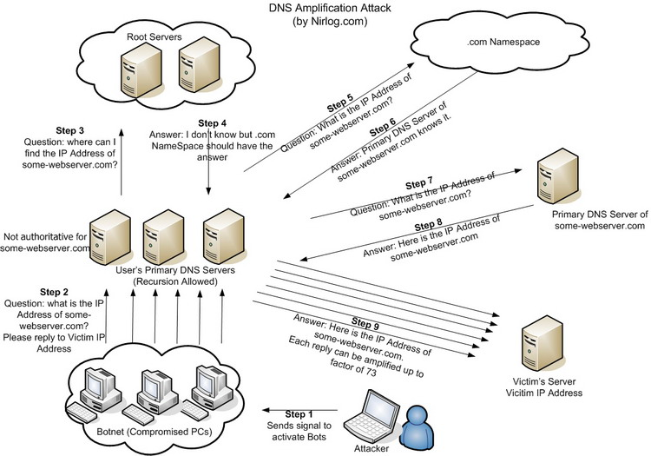
DNS Amplification Attack

Slide 60
DNS Security
DNS Hijack: Cutting the binding between name and IP
DNS DoS (Denial of Service) attack
BAOFENG.com & DNSPod
2009-5-18: DNSPod was attacked and banned
2009-5-19: The Internet in China was almost down
Fixed timer: query for BAOFENG.com once per second!
Solutions
/etc/hosts, dnsmasq, OpenDNS, etc.
DNS shield to defend against DoS attack

Slide 61

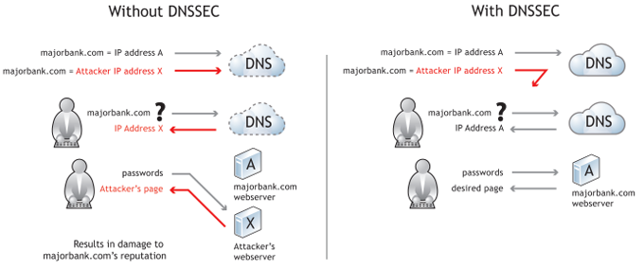
DNSSEC: Protect DNS Record
Only part of the zones are using DNSSEC, e.g., .gov, .org

Slide 62
Naming Scheme
Naming: the glue of modules

Slide 63
Naming in General
ipads.se.sjtu.edu.cn – hostname
steven@apple.com - email
steven – username
EAX - x86 processor register name
main() - function name
WebBrowser - class name
/courses/cse/index.html - path name (fully-qualified)
index.html - path name (relative)
http://ipads.se.sjtu.edu.cn/courses/cse/index.html - URL
13918275839- Phone number
202.120.40.188 - IP Address

Slide 64
Naming a Disk
File name: /dev/sda1
As a special type of inode: device inode
8,0 as (major, minor)
PCI address (name): 19:00.0
SCSI storage controller: LSI Logic / Symbios Logic SAS1068E PCI-Express Fusion-MPT SAS (rev 08)

Slide 65
Naming for Modularity
Retrieval: e.g., using URL to get a web page
Sharing: e.g., passing an object reference to a function
Save space as well: only sending the name, not the object
Hiding: e.g., using a file name without knowing file system
Can support access control: use an object only if knowing its name
E.g., Windows has many undocumented API
User-friendly identifiers: e.g., “homework.txt” instead of 0x051DE540
Indirection: e.g., OS can move the location of the file data without notifying the user
Have you ever defragmented your hard driver?

Slide 66
Addresses as Names
Software uses these names in an obvious way
E.g., memory addresses
Hardware modules connected to a bus
Use bus addresses (a kind of name) for interconnection

Slide 67
Naming Schemes
A naming schemes contains three parts:
1. Set of all possible names
You cannot use ‘for’ as a variable in C
2. Set of all possible values
3. Look-up algorithm to translate a name into a value
or a set of values, or “none”

Slide 68
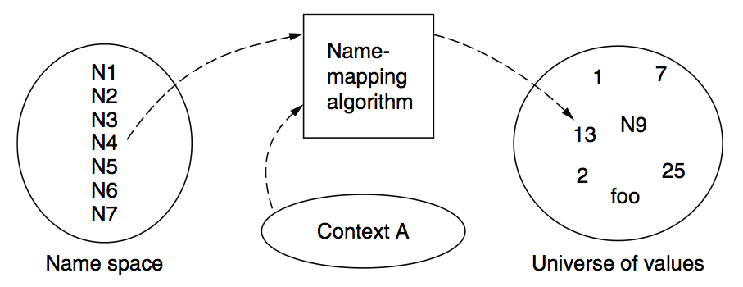
Naming Model

Slide 69
Naming Terminology
Binding – A mapping from a name to value
Unbind is to delete the mapping
A name that has a mapping is bound
A name mapping algorithm resolves a name

Slide 70
Naming Context
Type-1: context and name are separated
E.g., inode number’s context is the file system
Type-2: context is part of the name
E.g., xiayubin@sjtu.edu.cn
Name spaces with only one possible context are called universal name spaces
Example: credit card number, UUID, email address

Slide 71
Determining Context - 1
Hard code it in the resolver
Examples: Many universal name spaces work this way
Embedded in name itself
cse@sjtu.edu.cn:
Name = “cse”
Context = “sjtu.edu.cn”
/ipads.se.sjtu.edu.cn/courses/cse/README :
Name = “README”
Context = “/ipads.se.sjtu.edu.cn/courses/cse”

Slide 72
Determining Context - 2
Taken from environment (Dynamic)
Unix cmd: “rm foo”:
Name = “foo”, context is current dir
Question: how to find the binary of “rm” command?
Read memory 0x7c911109:
Name = “0x7c911109”,
Context is thread’s address space
Many errors in systems due to using wrong context

Slide 73
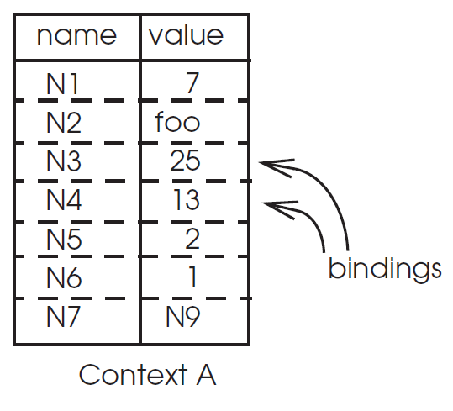
Name Mapping Algorithms - 1
Table lookup
Find name in a table
E.g., Phone book
Context: which table?
Implicit VS. explicit
Default context

Slide 74
Name Mapping Algorithms - 2
Recursive lookup
E.g., “/usr/bin/rm”
First find “usr” in “/”, then find “bin” in “/usr”, then “rm”
Each look-up process is the same
Multiple lookup
Recall: how to find “rm” without absolute name?
$PATH
E.g., “/usr/local/sbin:/usr/local/bin:/usr/sbin:/usr/bin:/sbin:/bin”
Look-up in a predefined list of context

Slide 75
Interpreter Naming API
value ← RESOLVE(name, context)
Return the mapping of name in the context
status ← BIND(name, value, context)
Establish a name to value mapping in the context
status ← UNBIND(name, context)
Delete name from context
list ← ENUMERATE(context)
Return a list of all bindings
result ← COMPARE(name1, name2)
Check if name1 and name2 are equal

Slide 76
FAQ of Naming Scheme - 1
What is the syntax of names?
What are the possible value?
What context is used to resolve names?
Who specifies the context?
Is a particular name global (context-free) or local?

Slide 77
FAQ of Naming Scheme - 2
Does every name have a value?
Or, can you have “dangling” names?
Can a single name have multiple values?
Does every value have a name?
Or, can you name everything?
Can a single value have multiple names?
Or, are there synonyms?
Can the value corresponding to a name change over time?

